Slide 1
Capstone Engagement
Assessment, Analysis, and Hardening of a Vulnerable System

Slide 2
Table of Contents
This document contains the following sections:
01
Network Topology
02
Red Team: Security Assessment
03
Blue Team: Log Analysis and Attack Characterization
Hardening: Proposed Alarms and Mitigation Strategies
04

Slide 3
Network Topology
3

Slide 4
Network Topology
[Insert Here]
Use draw.io to create a diagram of the network.
Add your diagram to this slide and fill out the data in the sidebar.
Network
Address Range:
Netmask:
Gateway:
Machines
IPv4:
OS:
Hostname:
IPv4:
OS:
Hostname:
IPv4:
OS:
Hostname:
IPv4:
OS:
Hostname:

Slide 5

Red Team
Security Assessment
5

Slide 6
Recon: Describing the Target
Nmap identified the following hosts on the network:
Hostname | IP Address | Role on Network
ML-RefVm-684427 | 192.168.1.1 | Windows Host
Unknown | 192.168.1.100 | ELK Server
Unknown | 192.168.1.90 | Attack machine
Unknown | 192.168.1.105 | Victim (Web-Server)

Slide 7
Vulnerability Assessment
The assessment uncovered the following critical (CVSS>9) vulnerabilities in the target:
Vulnerability | Description | Impact
CVE-1999-0661 | The system is running a version of software that was replaced with a Trojan horse | Allows an attacker to run commands on the target over ssh
CVE-2012-2379 | Apache CXF 2.4.x before 2.4.8, 2.5.x before 2.5.4, and 2.6.x before 2.6.1, when a Supporting Token specifies a child WS-SecurityPolicy 1.1 or 1.2 policy, does not properly ensure that an XML element is signed or encrypted, which has unspecified impact and attack vectors. | Allows an attacker to bypass secure session over http.

Slide 8
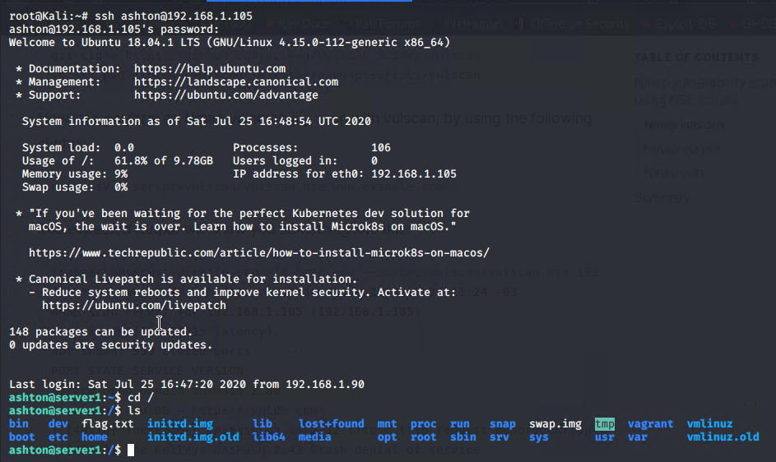
Exploitation: CVE-1999-0661
01
02
03
Tools & Processes
Using the web browser, the attacking machine was able to access the password for ashton. Then running an ssh using ashton as username and leopoldo as password
Achievements
Gained access to the webserver machine

Slide 9
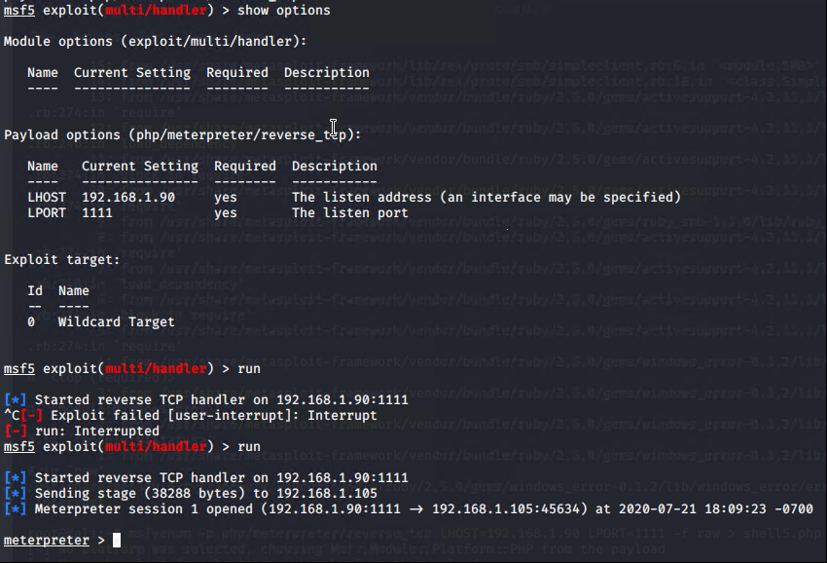
Exploitation: CVE-2012-2379
01
02
03
Tools & Processes
Used msfvenom to create a reverse shell payload. Transferred the payload over file explorer. Setup a metasploit reverse shell listener. Executed the payload on the vicim by navigating to the payload though web browser.
Achievements
Established a remote session with the victim. Downloaded the flag and secret files.

Slide 10

Blue Team
Log Analysis and Attack Characterization
10

Slide 11

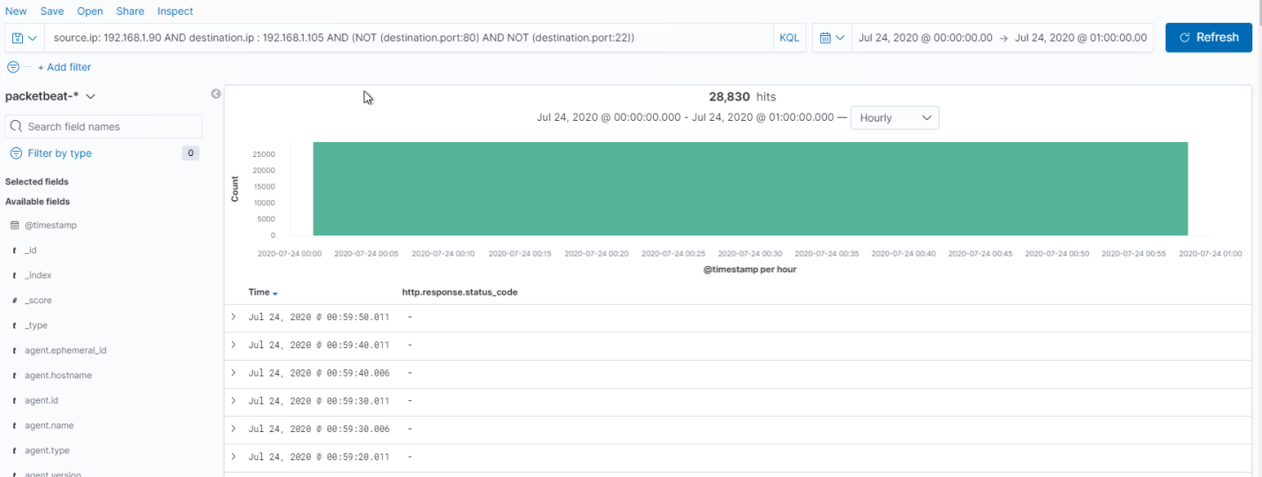
Analysis: Identifying the Port Scan
Answer the following questions in bullet points under the screenshot if space allows. Otherwise, add the answers to speaker notes.
What time did the port scan occur? Between Midnight and 1AM on July 24th
How many packets were sent, and from which IP? 28,830
What indicates that this was a port scan? Each log was different destination port number.

Slide 12
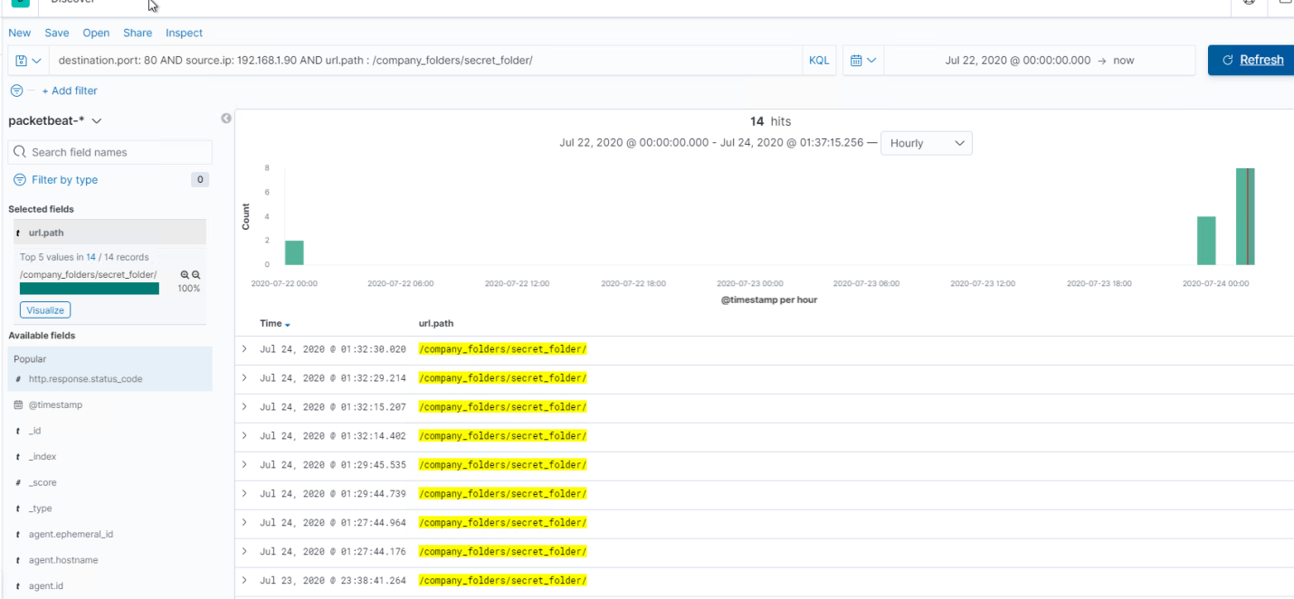
Analysis: Finding the Request for the Hidden Directory
Answer the following questions in bullet points under the screenshot if space allows. Otherwise, add the answers to speaker notes.
What time did the request occur?July 24th at 1:22 AM
How many requests were made? 14
Which files were requested? What did they contain? Secret folder conatining the password for Ryan

Slide 13
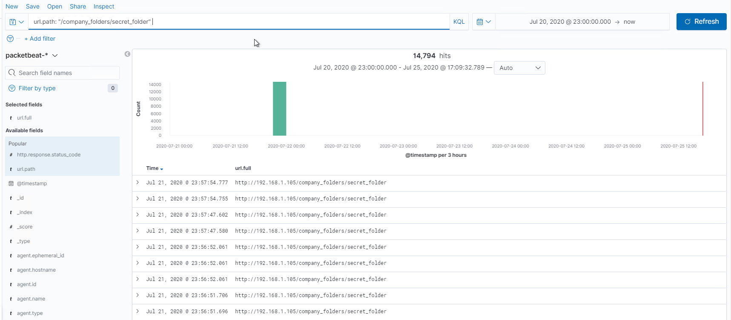
Analysis: Uncovering the Brute Force Attack
Answer the following questions in bullet points under the screenshot if space allows. Otherwise, add the answers to speaker notes.
How many requests were made in the attack? 14794
How many requests had been made before the attacker discovered the password? 14794 because the scan was stopsed after the brute force login attempt was a success.

Slide 14
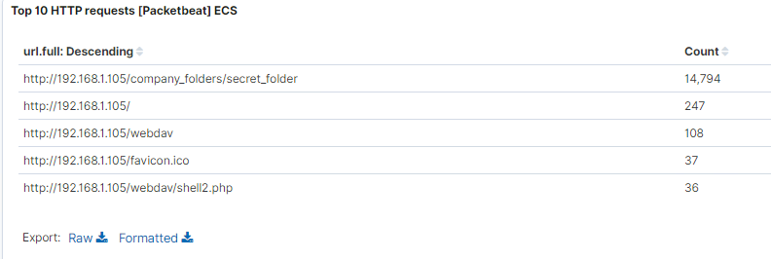
Analysis: Finding the WebDAV Connection
Answer the following questions in bullet points under the screenshot if space allows. Otherwise, add the answers to speaker notes.
How many requests were made to this directory? 36
Which files were requested? Shell2.php

Slide 15
Blue Team
Proposed Alarms and Mitigation Strategies
15

Slide 16
Mitigation: Blocking the Port Scan
What kind of alarm can be set to detect future port scans?
A check for greater than 10 requests on ports other than 80 and 22.
What threshold would you set to activate this alarm?
In theory there should be no requests to any port outside 80 and 22 but to prevent any flase alarms, we can set it to 10.
What configurations can be set on the host to mitigate port scans?
Implementing an adaptive firewall that notifies the SOC admin when it detects scanning activity. At a minimum using a firewall. Additionally, set max login attempts number to be flagged when a brute force is underway.
Describe the solution. If possible, provide required command lines.

Slide 17
Mitigation: Finding the Request for the Hidden Directory
What kind of alarm can be set to detect future unauthorized access?
An alarm triggered if someone tries to access a folder outside of the available folder.
What threshold would you set to activate this alarm?
Set to one because we don’t want any one to access it.
What configuration can be set on the host to block unwanted access?
Prevent access to this file and folder over the web.
Describe the solution. If possible, provide required command lines.

Slide 18
Mitigation: Preventing Brute Force Attacks
What kind of alarm can be set to detect future brute force attacks?
We could set an alert if 401 Unauthorized is returned from any server over a certain threshold that would weed out forgotten passwords.
What threshold would you set to activate this alarm?
10 an hour
What configuration can be set on the host to block brute force attacks?
After 10 unauthorized access requests, the webserver can terminate connectiosn to the offender.
Describe the solution. If possible, provide the required command line(s).

Slide 19
Mitigation: Detecting the WebDAV Connection
What kind of alarm can be set to detect future access to this directory?
Create an alert anytime this directory is accessed by a machine other than the machine that should have access.
What threshold would you set to activate this alarm?
0 per hour
What configuration can be set on the host to control access?
Prevent access to this file and folder.
Describe the solution. If possible, provide the required command line(s).

Slide 20
Mitigation: Identifying Reverse Shell Uploads
What kind of alarm can be set to detect future file uploads?
If the firewalls are implemented as recommended in previous slides, this outgoing traffic will be blocked form this port.
What threshold would you set to activate this alarm?
0 per hour
What configuration can be set on the host to block file uploads?
Removing the ability to upload files to this directory over port 80.
Describe the solution. If possible, provide the required command line.

